Slide 1

QUANTIFYING THE AIRLINE “MONOPOLY TAX”
MIST 6380
By: Ben An, Dan Mosu, Kai Clancy, Kate Bloom, Priyanka Govani
10/22/2026
Notes:
Open with the one-line thesis: nationally the airline industry looks competitive, but on specific hub-dominated corridors a single carrier sets the price. Today we quantify that gap, the “monopoly tax,” using DOT fare data and jet fuel spot prices. Introduce the team, then move to the business context.

Slide 2



BUSINESS CONTEXT: THE AIRLINE MONOPOLY TAX
THE PROBLEM
Route-Level Concentration
Cost Decoupling (“Monopoly Tax”)
Analytical Objective
Benchmark Department of Transportation ticket pricing against jet fuel spot prices
Industry looks competitive nationally
In captive markets, fares decouple from baseline operating costs
Hub dominance creates localized monopolies on high-traffic direct corridors
Quantify market-power premiums across route categories
Dominant carriers sustain price markups regardless of fuel trends
Quantifying the Airline “Monopoly Tax” · MIST 6380
02
Notes:
Walk left to right. 1) Route-level concentration: nationally the industry appears competitive, but hub dominance creates localized monopolies on high-traffic direct corridors. 2) Cost decoupling, our “monopoly tax”: in captive markets, airfares decouple from baseline operational costs, so dominant carriers can sustain price markups regardless of fuel trends. 3) Our objective: benchmark Department of Transportation ticket pricing against jet fuel spot prices to quantify the size of the market-power premium across route categories.

Slide 3




PIPELINE ARCHITECTURE
THE METHOD
Sources
Python / Pandas Processing
Analytical Output
DOT Airfare API / Datasets
+ EIA Jet Fuel Spot Prices
Data Cleaning
O&D Alignment
HHI & Market Share Computation
Merged Panel Dataset
Regression / Price Premium Analysis
DATA SOURCING
TRANSFORMATION & MERGING
FEATURE CONSTRUCTION
Dual ingestion
DOT DB1B / BTS domestic airfares
EIA jet fuel spot price benchmarks
Cleaned multi-carrier itineraries
Standardized O&D airport pairs
Aligned fuel prices with ticket timelines
Route-level carrier concentration (HHI)
Fuel cost-to-fare ratios
Competitive vs. hub-dominated routes
Sources: DOT DB1B/BTS · EIA jet fuel spot prices · 2022 Q1–2026 Q1
03
Notes:
Follow the arrows. Step 1, sourcing: dual ingestion, combining DOT DB1B/BTS domestic airfare data with EIA jet fuel spot price benchmarks. Step 2, Python/Pandas: we cleaned multi-carrier itineraries, standardized origin-and-destination airport pairs, and aligned fuel spot prices with ticket transaction timelines, then computed HHI and market share. Step 3, output: a merged panel dataset feeding the regression and price-premium analysis. Features we built: route-level carrier concentration (HHI) and fuel cost-to-fare ratios, compared across competitive vs. hub-dominated routes.

Slide 4
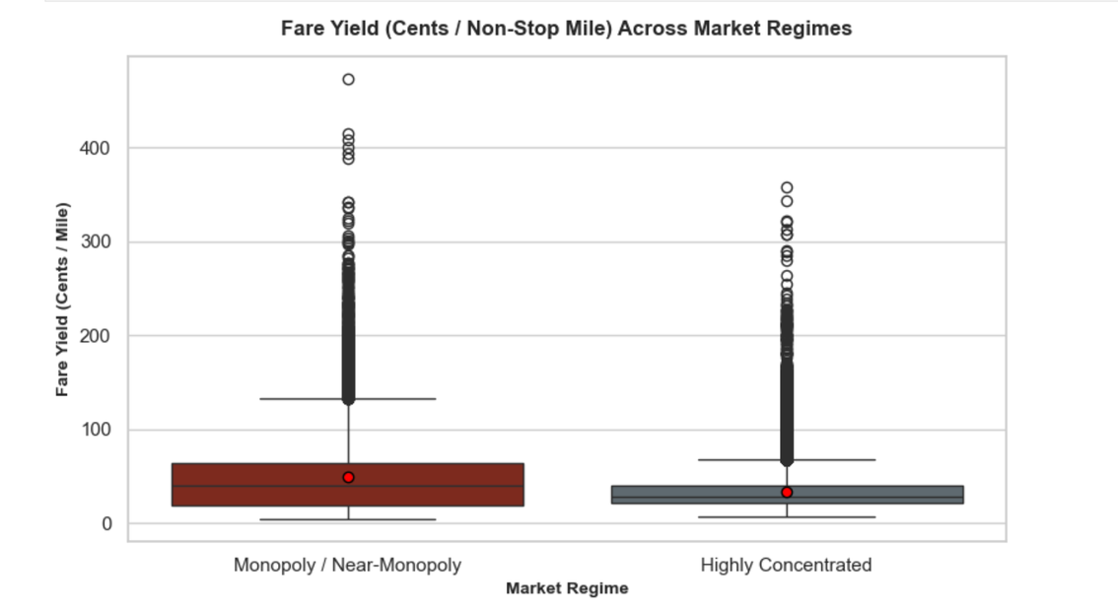



KEY FINDING 1: ROUTE CONCENTRATION MARKUPS
FINDING 1 OF 3
Monopoly Route Premiums
Single-carrier routes: higher median fares and heavy upper-quartile outliers vs. competitive corridors
Progressive Margin Compression
Median fares step down from duopolies to competitive multi-carrier routes (HHI < 2,500)
Distribution Skew
Wider IQR on monopoly and dominant-hub routes: carrier price-setting discretion and inelastic demand extraction
Fare yield (¢ per non-stop mile) by market regime
Quantifying the Airline “Monopoly Tax” · MIST 6380
04
Notes:
Point to the red box first: routes operated as single-carrier monopolies show significantly higher median fares and pronounced upper-quartile outliers compared with competitive corridors. Second, margin compression: median ticket prices step down consistently as competition increases, from duopolies to competitive multi-carrier routes (HHI under 2,500). Third, distribution skew: monopolized and dominant-hub routes have wider interquartile ranges, which signals carrier price-setting discretion and inelastic demand extraction.

Slide 5
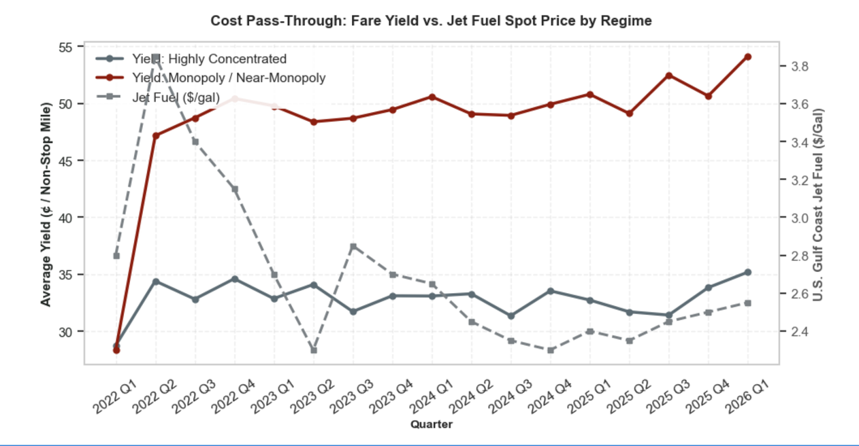



KEY FINDING #2 — COST PASS-THROUGH & FUEL PRICE DECOUPLING
FINDING 2 OF 3
Fuel Elasticity
Competitive routes shadow kerosene spot swings: standard cost-to-price transmission
Asymmetric Pricing (Rockets & Feathers)
Monopoly corridors: fuel spikes pass through fast and amplified, while fare drops lag fuel declines
Margin Expansion
After the 2022 Q2 fuel peak, prices fell but monopoly yields held near 48–54¢ per mile vs. 31–35¢ on highly concentrated routes
Fare yield vs. jet fuel spot price, by regime and quarter
Quantifying the Airline “Monopoly Tax” · MIST 6380
05
Notes:
Read the chart: the dashed gray line is the Gulf Coast jet fuel spot price, the burgundy line is monopoly or near-monopoly yield, and the slate line is highly concentrated yield. Fuel elasticity: competitive routes closely shadow kerosene spot price swings, which is standard cost-to-price transmission. Asymmetric pricing, “rockets and feathers”: on monopoly corridors, fare drops lag fuel price declines, while fuel spikes are passed through rapidly and amplified. Margin expansion: when jet fuel trends downward, the spread between fuel costs and monopoly yields widens rather than returning consumer savings. Specifically, jet fuel peaked in 2022 Q2 and then fell, with a brief rebound in 2023 Q3, yet monopoly and near-monopoly yield stayed elevated at roughly 48–54¢ per non-stop mile and edged up to about 54¢ by 2026 Q1, versus roughly 31–35¢ for highly concentrated routes. These figures are read off the chart, so confirm them against the underlying data before presenting.

Slide 6
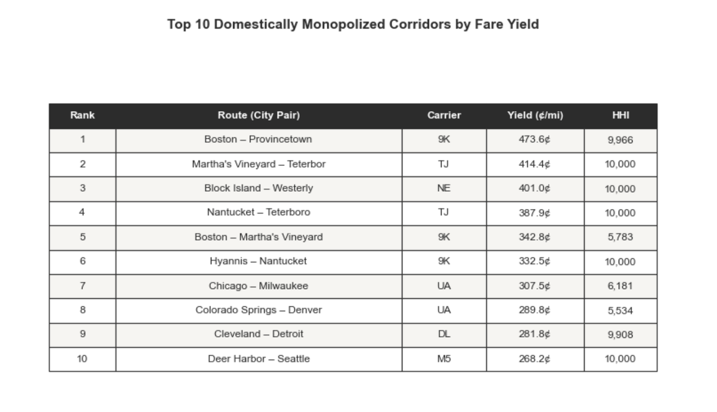


KEY FINDING 3: AMERICA’S TOP 10 MARKED-UP CORRIDORS
FINDING 3 OF 3
Extreme Route Yields
268¢–474¢ per non-stop mile: premiums over 12-25x the competitive baselines (typically 18¢–22¢/mile)
Captive Spoke & Hub Vulnerability
Single carriers feed fortress hubs, leaving regional passengers zero non-stop alternatives
Persistent Fuel Inelasticity
Despite big drops in kerosene spot prices, yields on these 10 routes stayed flat or expanded
Top 10 domestically monopolized corridors by fare yield
Quantifying the Airline “Monopoly Tax” · MIST 6380
06
Notes:
Walk the table from Boston–Provincetown down to Deer Harbor–Seattle. Extreme route yields: the top 10 marked-up corridors show fare yields of roughly 268¢ to 474¢ per non-stop mile, about 12 to 25 times the competitive domestic baselines of typically 18¢ to 22¢ per mile. Captive spoke and hub vulnerability: these corridors are dominated by single carriers feeding fortress hubs, so regional passengers have no non-stop alternative. Persistent fuel inelasticity: despite significant declines in kerosene spot prices, yields on these 10 routes stayed flat or expanded. Likely questions: (1) Many of these are very short hops, such as Boston–Provincetown and Block Island–Westerly, so yield per mile is inflated because fixed costs are spread over fewer miles. (2) Three corridors have an HHI of about 5,500 to 6,200, so they are dominant rather than strict monopolies. (3) The fuel point links back to the Finding 2 chart; this table shows yields only.

Slide 7


PRACTICAL APPLICATIONS & STAKEHOLDER VALUE
THE IMPACT
Corporate Travel Managers
Consumer Transparency
Antitrust & Regulatory Policy
Build dynamic HHI and carrier-concentration thresholds into procurement engines
Fair-fare benchmarking tools
Shift merger and slot-allocation reviews from broad national capacity metrics to route-level concentration indices
Expected price built from non-stop distance and prevailing jet fuel spot rates
Flag captive routes and mandate alternative secondary hubs
Alert travelers when a quote carries an exorbitant monopoly premium
Protect captive regional spoke markets from unconstrained rent extraction
Negotiate volume discounts on marked-up corridors
Quantifying the Airline “Monopoly Tax” · MIST 6380
07
Notes:
Three audiences. Corporate travel managers: incorporate dynamic HHI and carrier-concentration thresholds into procurement engines to identify captive routes, mandate alternative secondary hubs, and negotiate volume discounts on marked-up corridors. Consumers: fair-fare benchmarking tools compute an expected ticket price from non-stop distance and prevailing jet fuel spot rates, and alert travelers when a quote includes an exorbitant monopoly premium. Regulators: shift merger and slot-allocation evaluations from broad national capacity metrics to granular route-level concentration indices, protecting captive regional spoke markets from unconstrained rent extraction.

Slide 8
LIMITATIONS & PIPELINE SCALABILITY
NEXT STEPS
01
DATA GRANULARITY CONSTRAINTS
ECONOMETRIC & CAUSAL IDENTIFICATION
SCALABILITY & PRODUCTION ROADMAP
02
03
Ticketing Lag & Survey Scope
DOT DB1B is a 10% survey sample, reported quarterly. It hides intra-month pricing, day-of-week surges and last-minute business fares.
Endogenous Fleet Deployment
Real-Time API Ingestion
Aircraft gauge and seating density vary with route density. Stage-length controls can’t fully absorb the unobserved cost efficiencies.
Move from historical BTS batch ingestion to live GDS / Google Flights API scrapers to track markups ahead of departure.
Unbundling Omission
Fares exclude bags, seats and change fees, understating true yield on Ultra-Low-Cost Carriers (ULCCs).
Alternative Routing Baselines
Predictive Fair-Fare Microservice
Models cover direct O&D pairs only. Adding connecting hub itineraries is needed to quantify full substitution elasticity.
Automated pricing engine flags anti-competitive corridor premiums and publishes monthly carrier concentration scorecards.
Quantifying the Airline “Monopoly Tax” · MIST 6380
08
Notes:
Be upfront about limits, then show the roadmap. 1) Data granularity: DOT DB1B is a 10% survey sample reported quarterly, so it obscures intra-month dynamic pricing, day-of-week surges and last-minute business fare spikes. Fares also exclude ancillary revenue (checked bags, seat selection, change fees), which understates true consumer yield on ultra-low-cost carriers. 2) Econometrics: aircraft gauge and seating density vary systematically with route density, adding unobserved cost efficiencies that raw stage-length controls cannot fully absorb. Our yield models evaluate direct origin-destination pairs; adding connecting hub itineraries would quantify full substitution elasticity. 3) Roadmap: move from historical BTS batch ingestion to live GDS / Google Flights API scrapers to track fare markups ahead of departure windows, and deploy a predictive fair-fare microservice that flags anti-competitive corridor premiums and publishes monthly carrier concentration scorecards.

